Slide 1
DATA STRUCTURES AND ALGORITHMS
DATA ORGANIZATION
WEEK 2

Slide 2
INTRODUCTION
Data structures and algorithms are important for programmers to solve complex problems. Organizing data effectively is crucial for the efficient use of these tools.
By the end, you will better understand the crucial role of data organization in programming, helping you to become a more effective problem solver.

Slide 3
DATA ORGANIZATION
Data organization is the arrangement and structuring of data within a data structure, to facilitate efficient storage, retrieval, and manipulation.

Slide 4
IMPORTANCE OF DATA ORGANIZATION
Efficiency in Algorithmic Processing
Optimized Access:
Well-organized data structures lead to faster access and retrieval of information.
Algorithms can process data more efficiently when it is stored in an organized manner.
Improved Search and Retrieval
Reduced Search Time:
Organized data allows for quicker search and retrieval operations.
Efficient search algorithms can take advantage of well-organized data structures.

Slide 5
IMPORTANCE OF DATA ORGANIZATION
Enhanced Code Readability
Clarity in Code:
Organized data structures enhance code readability.
Code becomes more understandable and maintainable, facilitating collaboration among developers.
Simplified Maintenance
Ease of Maintenance:
Organized data structures make it easier to maintain and update software.
Modifications and additions can be performed more seamlessly.

Slide 6
IMPORTANCE OF DATA ORGANIZATION
Adaptability to Changing Requirements
Adaptability:
Organized data structures provide adaptability to changing requirements.
Modifying or replacing them won't cause major disruptions to the overall system.
Data Security and Integrity
Enhanced Security:
Properly organized data contributes to data security.
Access controls and data integrity measures are more effectively implemented with organized data

Slide 7
TYPES OF DATA ORGANIZATION
Linear Structure: Linear data structures organize data elements sequentially linearly or sequentially.

Slide 8
TYPES OF DATA ORGANIZATION
Non-Linear Structure: Non-linear data structures organize data elements in a hierarchical or interconnected manner..

Slide 9
DATATYPES
Definition
Data types refer to the classification or categorization of data that a programming language or a data structure can handle.
Each data type has specific characteristics, constraints, and operations associated with it.
Data types are crucial in data structures as they define the nature of the elements stored and the operations that can be performed on those elements

Slide 10
TYPES OF DATATYPES
PRIMITIVE DATATYPES
Definition: Primitive data types are the fundamental building blocks of data, representing basic values directly supported by the programming language.
Examples of Datatypes include:
Integer: Represents whole numbers (e.g., 1, -5).
Float/Double: Represents real numbers with decimal points (e.g., 3.14).
Character: Represents a single character (e.g., 'A').

Slide 11
TYPES OF DATATYPES
PRIMITIVE DATATYPES
Characteristics:
Fixed size in memory.
Directly supported by the hardware.
Operations are basic and low-level.
Usage:
Efficient for simple and small-scale data representation.
Form the foundation for more complex data structures.

Slide 12
TYPES OF DATATYPES
ABSTRACT DATA TYPES (ADTS):
Definition: Abstract Data Types are high-level descriptions of data structures that focus on the behavior of the data and the operations that can be performed, without specifying the implementation details.
Stack: Supports operations like push and pop.
Queue: Supports operations like enqueue and dequeue.
Linked List: Supports operations like insertion and deletion.
Tree: Supports hierarchical representation with operations like traversal and search.

Slide 13
TYPES OF DATATYPES
ABSTRACT DATA TYPES (ADTS):
Characteristics:
Defined by operations, not implementation details.
Encapsulates data and operations within a single unit.
Allows for modularity and abstraction in programming.
Usage:
Provides a high-level blueprint for data structures.
Allows for separation of concerns, making code more modular and maintainable.
Supports the development of reusable and extensible software components.

Slide 14
PHYSICAL MEMORY AND LOGIC MEMORY
Managing computer memory is a vital part of computer systems. This involves how the operating system handles memory resources. The relationship between physical and logical memory management is crucial to this process. It affects how much memory is available and how it is used.

Slide 15
PHYSICAL MEMORY
Definition:
Physical memory, often referred to as RAM (Random Access Memory), is the actual hardware component where data and programs are stored temporarily during execution.
Characteristics:
Limited in size compared to storage devices like hard drives.
Directly accessed by the CPU for faster data retrieval.

Slide 16
LOGICAL MEMORY
Definition:
Logical memory is the conceptual address space that a program or process sees. It's the range of addresses that the CPU can use to reference data and instructions.
Characteristics:
Larger than physical memory and extends to the entire addressable space.
Provides a uniform address space for all processes, making them independent of the actual physical memory size.

Slide 17
THE RELATIONSHIP BETWEEN PHYSICAL AND LOGICAL MEMORY MANAGEMENT
Memory Segmentation:
Logical memory is often divided into segments, each corresponding to a specific type of data or code (e.g., code segment, data segment).
Physical memory is then divided into corresponding segments, and the mapping is managed by the operating system.

Slide 18
THE RELATIONSHIP BETWEEN PHYSICAL AND LOGICAL MEMORY MANAGEMENT
Paging:
In a paging system, logical memory is divided into fixed-size blocks called pages.
Physical memory is similarly divided into frames. The OS manages the mapping of pages to frames.

Slide 19
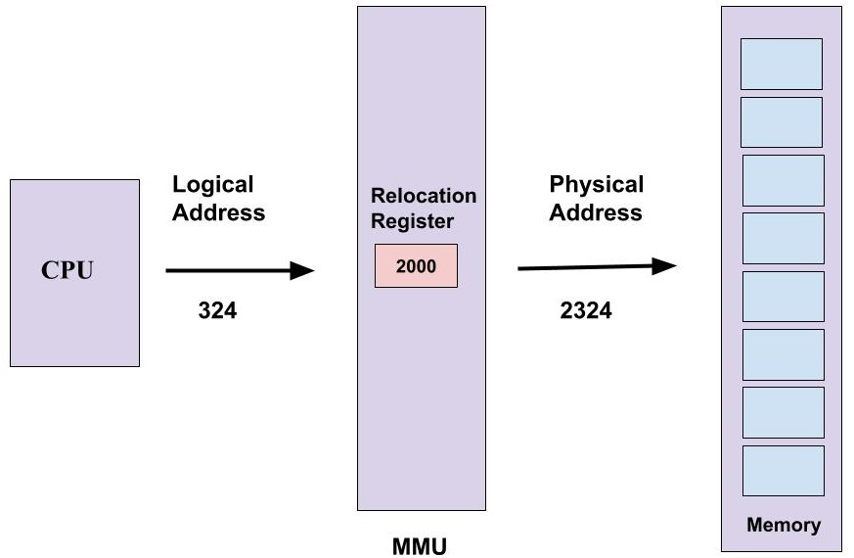
THE RELATIONSHIP BETWEEN PHYSICAL AND LOGICAL MEMORY MANAGEMENT
Address Translation:
The operating system uses mechanisms like page tables or segment tables to translate logical addresses used by the CPU into corresponding physical addresses in memory.

Slide 20
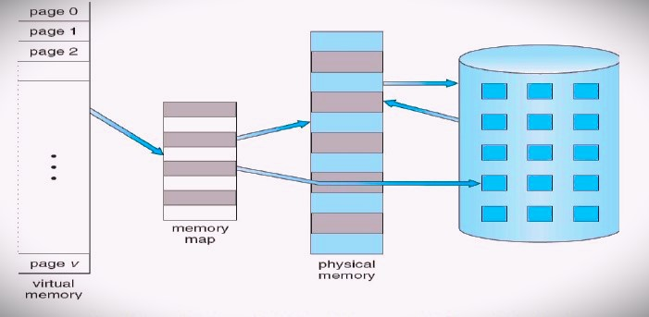
THE RELATIONSHIP BETWEEN PHYSICAL AND LOGICAL MEMORY MANAGEMENT
Virtual Memory:
Virtual memory extends the logical memory by using disk space as an extension of physical memory.
Pages of data are swapped in and out of physical memory as needed, allowing processes to operate as if they have more memory than physically available.

Slide 21
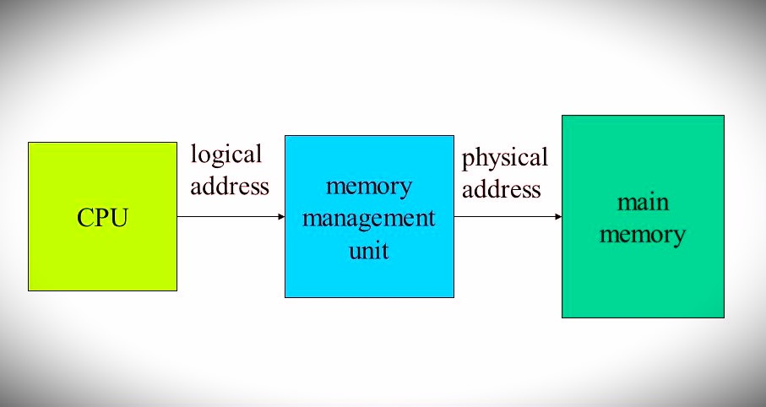
THE RELATIONSHIP BETWEEN PHYSICAL AND LOGICAL MEMORY MANAGEMENT
Memory Management Unit (MMU):
The MMU, a hardware component, handles the translation of logical addresses to physical addresses during the execution of a program.

